Slide 1
A Gentle Introduction to Clustering
Yongjia Wang

Slide 2
Two fundamental Questions about Clustering
What is clustering?
Why is clustering useful?

Slide 3









Two fundamental Questions about Clustering
What is clustering?
Grouping objects (data points)
Unsupervised learning
(clustering)
Supervised learning
(associative learning)
Class labels
Good
Bad
classification
“subjective” groupings
human interpretable
Values
y
regression
Notes:
In many practical cases, learning about the data itself is a pre-requisite to downstream associative supervised learning task.

Slide 4
Two fundamental Questions about Clustering
Why is clustering useful?
For human understanding
Big picture, insights
Early stage data analysis, especially for big data
Can be helpful to downstream supervised learning

Slide 5
User-site frequency: extremely sparse data
what’s the problem?
P-Unit | site1 | site2 | site3 | site4 | site5 | site6 | site7 | site8 | … millions of sites
p1 | 0 | 0 | 0 | 3 | 0 | 0 | 0 | 0
p2 | 0 | 0 | 0 | 0 | 0 | 0 | 0 | 0
p3 | 2 | 0 | 0 | 0 | 0 | 0 | 0 | 0
p4 | 0 | 0 | 0 | 0 | 0 | 0 | 0 | 0
p5 | 0 | 0 | 0 | 0 | 0 | 0 | 1 | 0
p6 | 0 | 0 | 0 | 0 | 0 | 0 | 0 | 0
p7 | 0 | 0 | 1 | 0 | 0 | 0 | 0 | 0
p8 | 0 | 0 | 0 | 0 | 0 | 0 | 0 | 0
… millions of users
P-Unit | Entertainment | Shopping | Finance | Game | … hundreds of categories
p1 | 10 | 1 | 0 | 0
p2 | 5 | 3 | 1 | 0
p3 | 100 | 0 | 0 | 6
p4 | 0 | 24 | 0 | 0
p5 | 0 | 5 | 0 | 7
p6 | 0 | 0 | 53 | 0
p7 | 0 | 15 | 0 | 2
p8 | 26 | 0 | 0 | 53
… millions of users
Grouping features
Notes:
Sparse data is very difficult to work with.
Intuitively, it brings little connections between cases, and therefore nothing useful can be learned.
For example, very specific mapping from site to score is built without useful generalization.

Slide 6
Gamers
P-Unit | Entertainment | Shopping | Finance | Game | … hundreds of categories
p1 | 10 | 1 | 0 | 0
p2 | 5 | 3 | 1 | 0
p3 | 100 | 0 | 0 | 6
p4 | 0 | 24 | 0 | 0
p5 | 0 | 0 | 0 | 0
p6 | 0 | 0 | 53 | 0
p7 | 0 | 15 | 0 | 2
p8 | 26 | 0 | 0 | 53
… millions of users
Geeks
Grouping users
Shoppers
Tens of categories
…
User behaviors can be dramatically different in different groups
Build user-category-specific supervised conversion models
Notes:
User-site data matrix are not random, there are always some simpler underlying models.

Slide 7
A Simple Synthetic Topic Model
For simplicity: 3 topics
User interests are measured by 3 topics
Website contents are measured by the same 3 topics
P-Unit (user-id) | Topic: Entertainment | Topic: Education | Topic: Other
p1 | 0.6 | 0.1 | 0.3
p2 | 0.3 | 0.4 | 0.3
p3 | 0.1 | 0.8 | 0.1
… millions of users
Sites (URL) | Topic: Entertainment | Topic: Education | Topic: Other
s1 | 0.9 | 0 | 0.1
s2 | 0.1 | 0.8 | 0.1
s3 | 0.4 | 0.3 | 0.3
… millions of sites
Notes:
The data matrix is not just random. It’s always generated by some underlying process, and the task of modeling is to learn these underlying processes.
Assume this is the underlying model that will generate the synthetic data

Slide 8
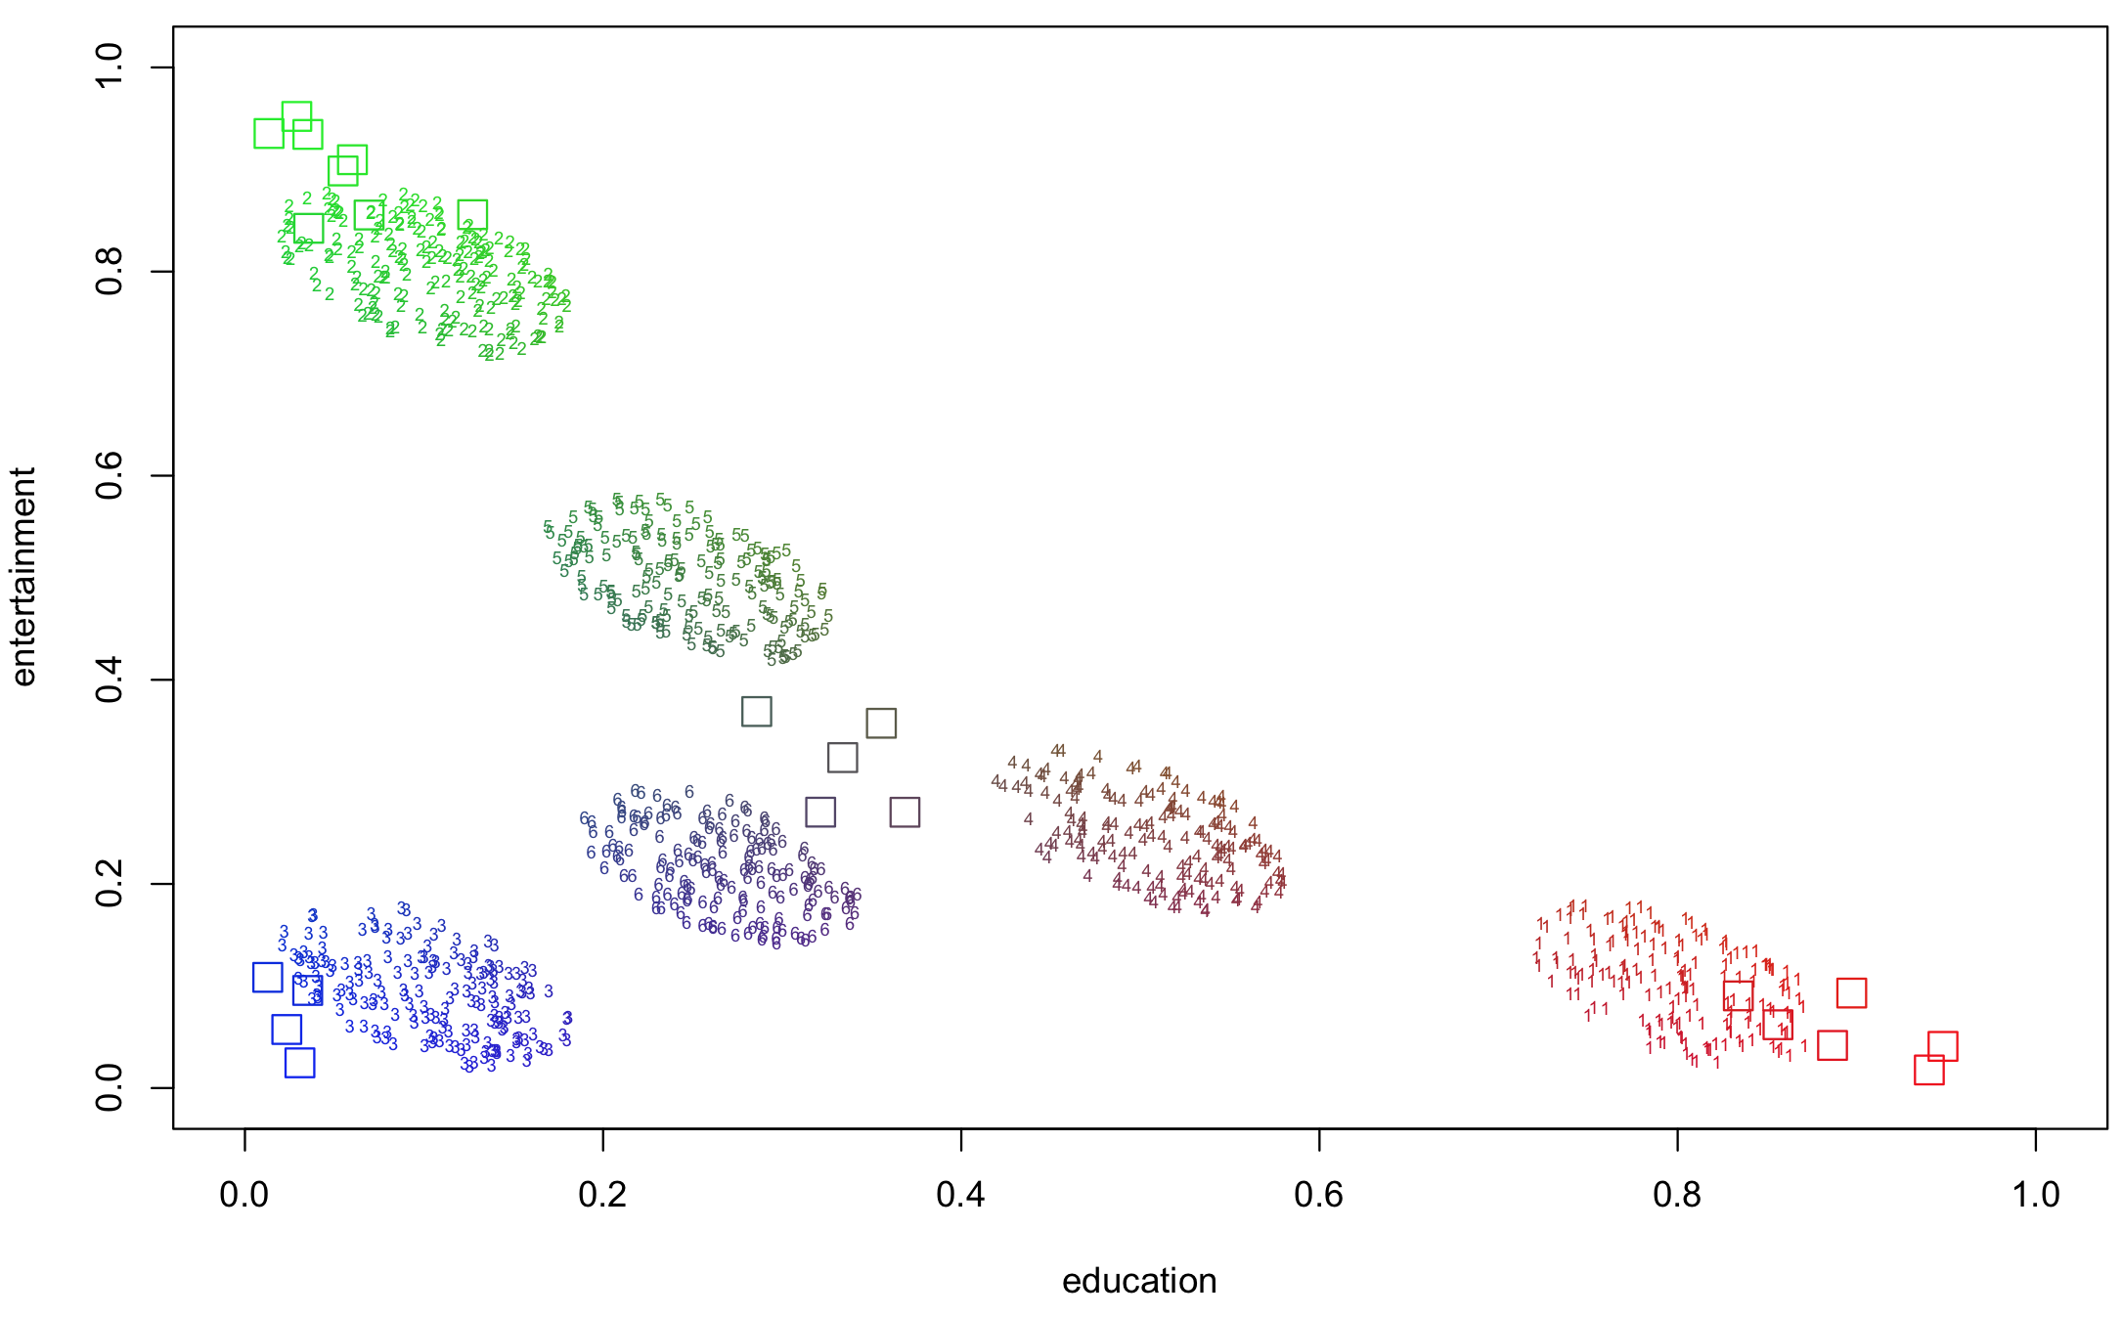
Synthetic user and site data in the 2-d topic space.
Users interested in a topic are more likely to visit sites focusing on the topic.
Color indicates composition.
1052 users
6 clusters
2 dimensional interest space
23 sites
4 clusters
2 dimensional content space
Notes:
Real data rarely has uniform distribution, it always forms clusters for various reasons.
Sites are created for different users.

Slide 9
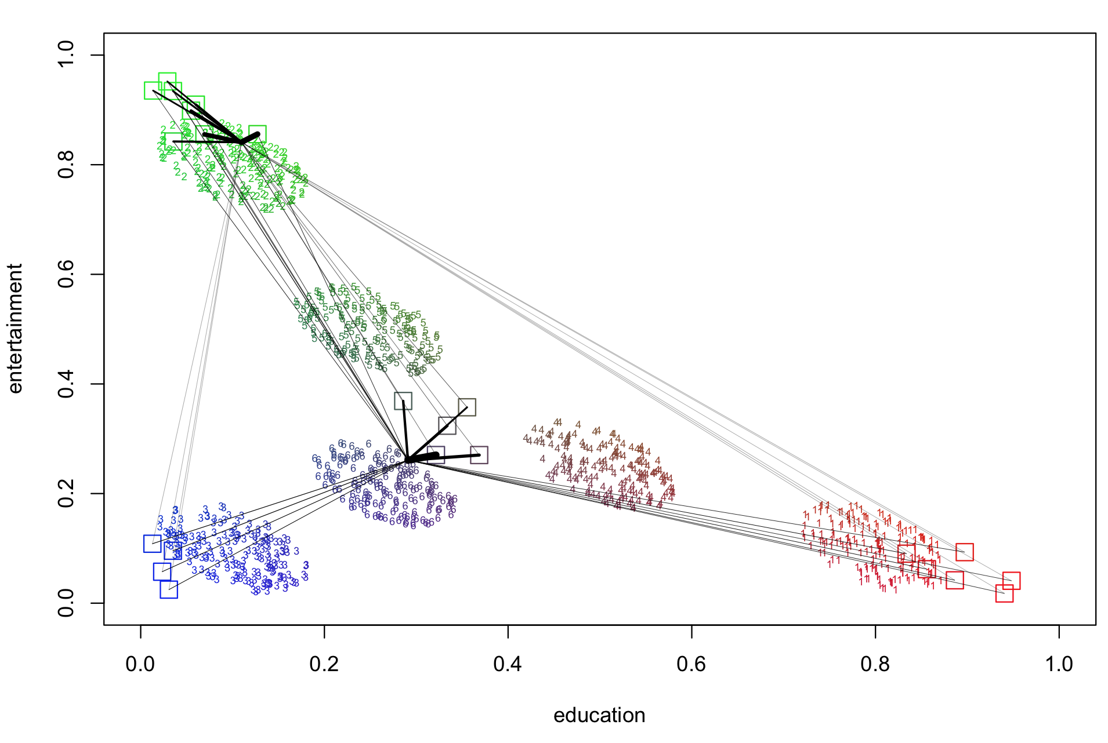
Relation between users and sites
The probability of a user visiting a site is proportional to 1/distance.
The width of the edge represents the probability.

Slide 10
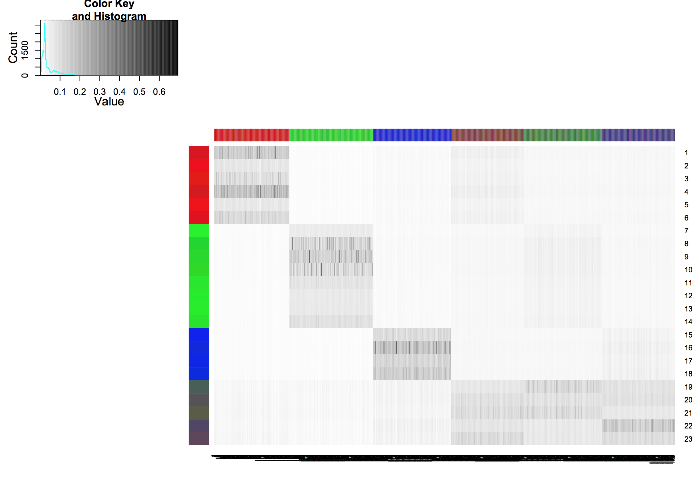
The synthetic data shows the site visiting probabilities for all users.
1052 users (observed)
6 clusters (not observed)
true dimensions: 2 (not observed)
observed dimensions: 23
23 sites (observed)
4 clusters (not observed)
true dimensions: 2 (not observed)
observed dimensions: 1052
Notes:
The actual observations are rounded frequency data, for simplicity, just use normalized probability.
In a real case, the visiting probabilities are observed, the colored clusters are not.
1/distance is a nonlinear monotonic transformation, which will distort the 2d data plane into higher dimensions.
But they are still in a 2d manifold as long as it’s a continuous distortion. 1/x needs to be a valid kernel

Slide 11
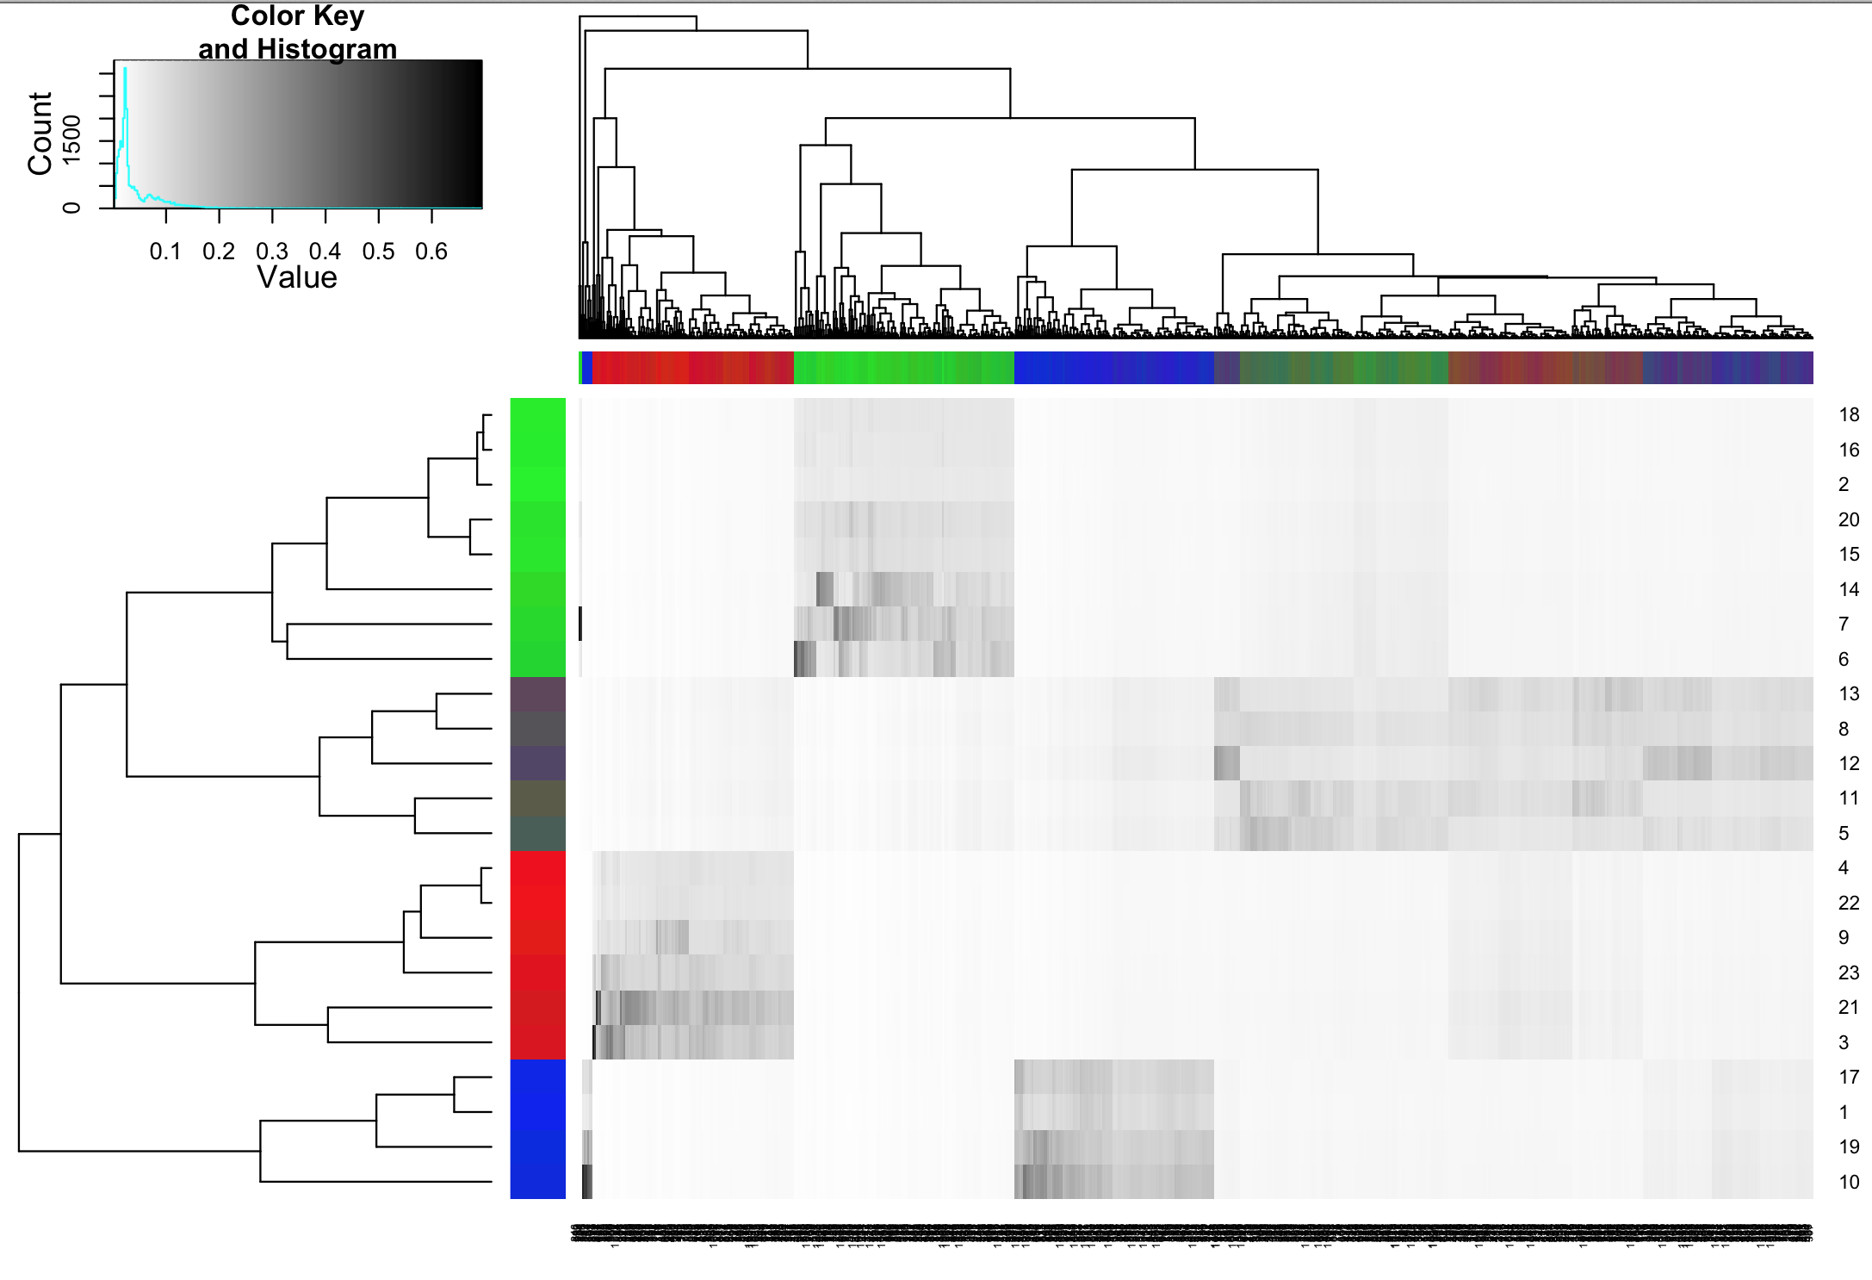
Hierarchical clustering for 1052 users in observed 23-dimensional space (a small error)
Hierarchical clustering for 23 sites in observed 1052-dimensional space (perfect)
Hierarchical clustering algorithm used Euclidean distance and complete-linkage method
Notes:
Perform hierarchical clustering using the observed data.
Columns and rows are reordered.

Slide 12
Two Challenges
Solving the clustering problem
NP-hard
Graph partition
Specifying the clustering problem
d-dimensional space: O(n^{dk})
n: number of data
d: number of dimensions
k: number of clusters
Subjective Choices:
feature space
clustering criteria
General Strategies:
distance metric
number of clusters
Dimension reduction
(reduce d)
Heuristic search
(greedy algorithm)
Recursive bipartition
(reduce k)
Tens of clustering algorithms: k-means, agglomerative hierarchical clustering, spectral clustering, kernel-based clustering, GMM, other probabilistic models …
Notes:
Outcome depending on subjective choices is not good.
Curse of dimensionality.
The hierarchical clustering algorithm just saw is greedy algorithm, can be badly stuck at local minimum when the landscape is complex: when there is large amount of data, high dimension
Dimension reduction approach leads to better global solution.
Recursive bipartition can always be used.

Slide 13
Albert Einstein:
“Everything should be made as simple as possible, but not simpler.”
Users
Sites
Users
Hidden Topics
Sites
T1
T2
Many weights - complex model
Fewer weights – simpler model
More interpretable
Notes:
A view that naturally leads to dimension reduction approach

Slide 14
Albert Einstein:
“Everything should be made as simple as possible, but not simpler.”
Users
Sites
Users
Hidden Topics
Sites
T1
T2
Decomposition

Slide 15
Albert Einstein:
“Everything should be made as simple as possible, but not simpler.”
Users
Sites
Users
Hidden Topics
Sites
T1
T2
Sharing weights
Good for learning from limited observation
Good for prediction (more generalizable)

Slide 16
Albert Einstein:
“Everything should be made as simple as possible, but not simpler.”
Users
Sites
Users
Hidden Topics
Sites
T1
T2
Lower dimension
Notes:
Many choices for the mathematical formulation

Slide 17
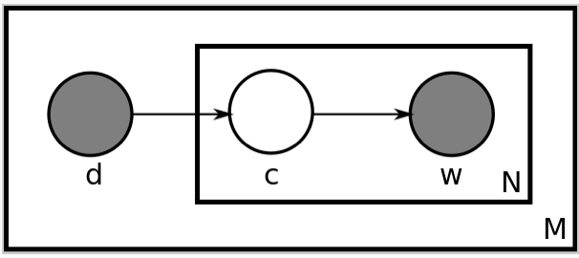
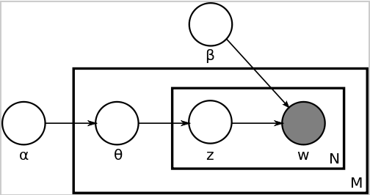
Many existing work for
Document and Word model
are applicable to User and Website relation
Linear Factorization
Probabilistic Model
P-LSA / p-LSI
(asymmetric)
plate notation
Latent Semantic Analysis (LSA)
Latent Semantic Indexing (LSI)
Singular Value Decomposition (SVD)
(symmetric treatment)
Latent Dirichlet Allocation (LDA)
(generative model)
Peter K’s work:
https://wiki.corp.qc/display/OPTM/Peter
Notes:
Relation between document and word is
analogous to user and site

Slide 18
Singular Value Decomposition
Users
Sites
Users
Hidden Topics
(latent semantic)
Sites
* λ1 *
+
* λ2 *
+
+
λ: singular values (weights)
related to eigenvalues (spectrum)
sites
topics
sites
0
weighted sum of element-wise products
topics
users
users
0
M
=
U
D
V^{T}
Notes:
Properties: singular vectors are orthonormal: meaning edge weights are normalized, and topics are independent
Always exist unique decomposition.

Slide 19
Low Rank Approximation Linear Dimension Reduction
Users
Sites
Users
Hidden Topics
(latent semantic)
Sites
* λ1 *
+
* λ2 *
+
+
λ: singular values (weights)
related to eigenvalues (spectrum)
sites
topics
sites
0
weighted sum of element-wise products
topics
users
users
0
M
=
U
D
V^{T}

Slide 20
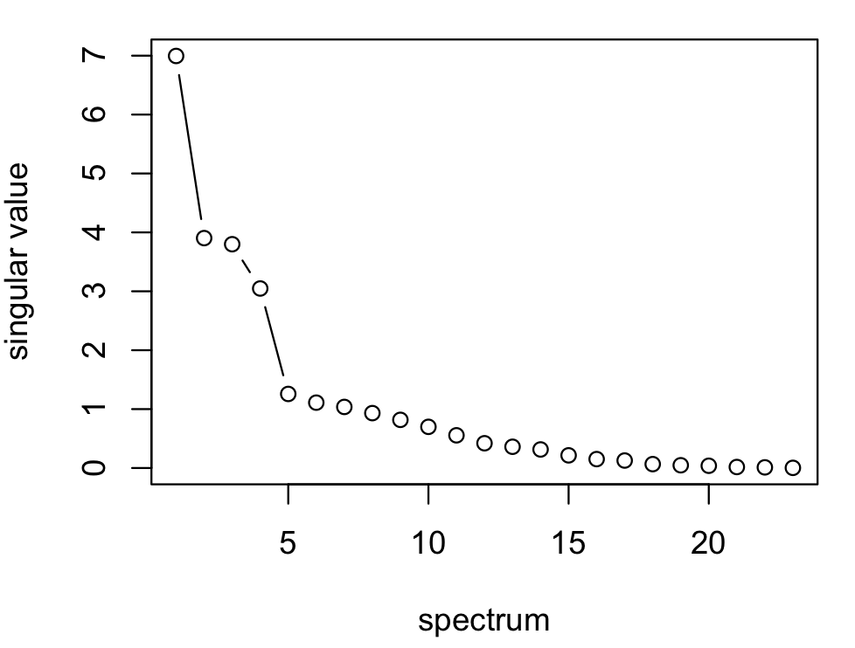
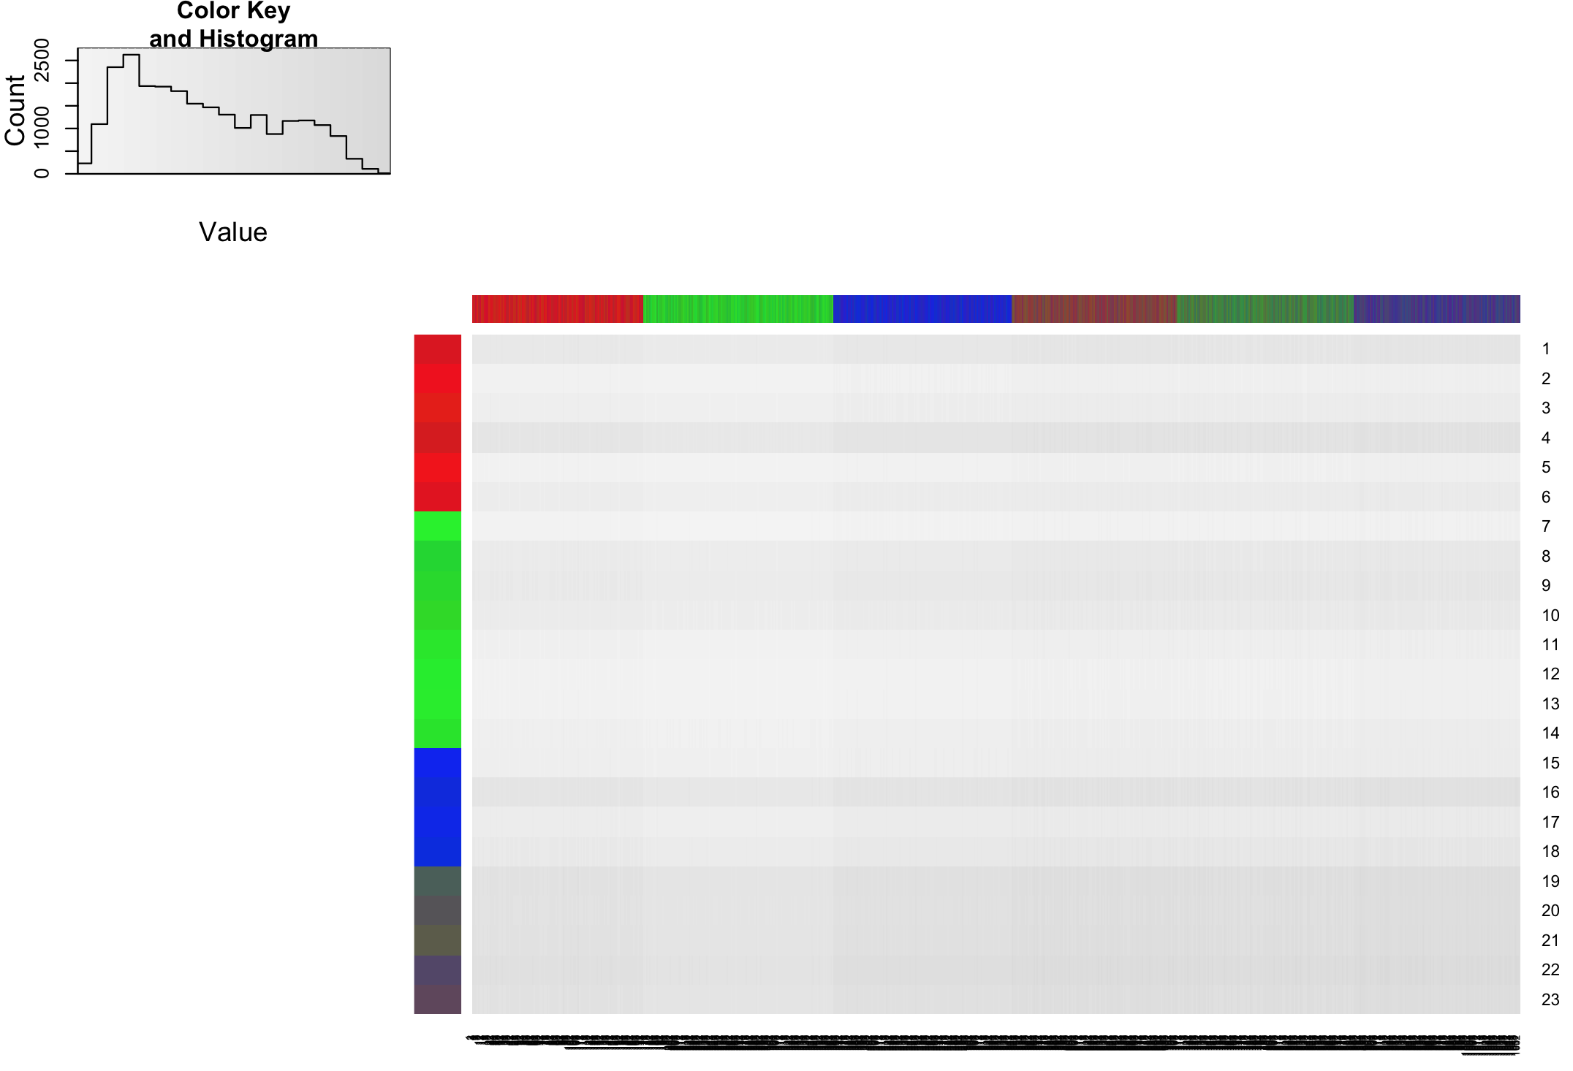
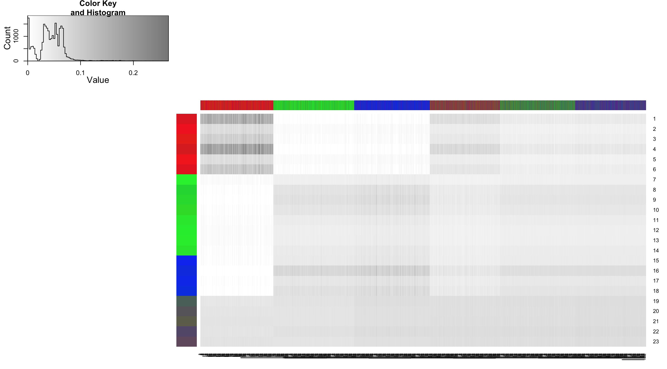
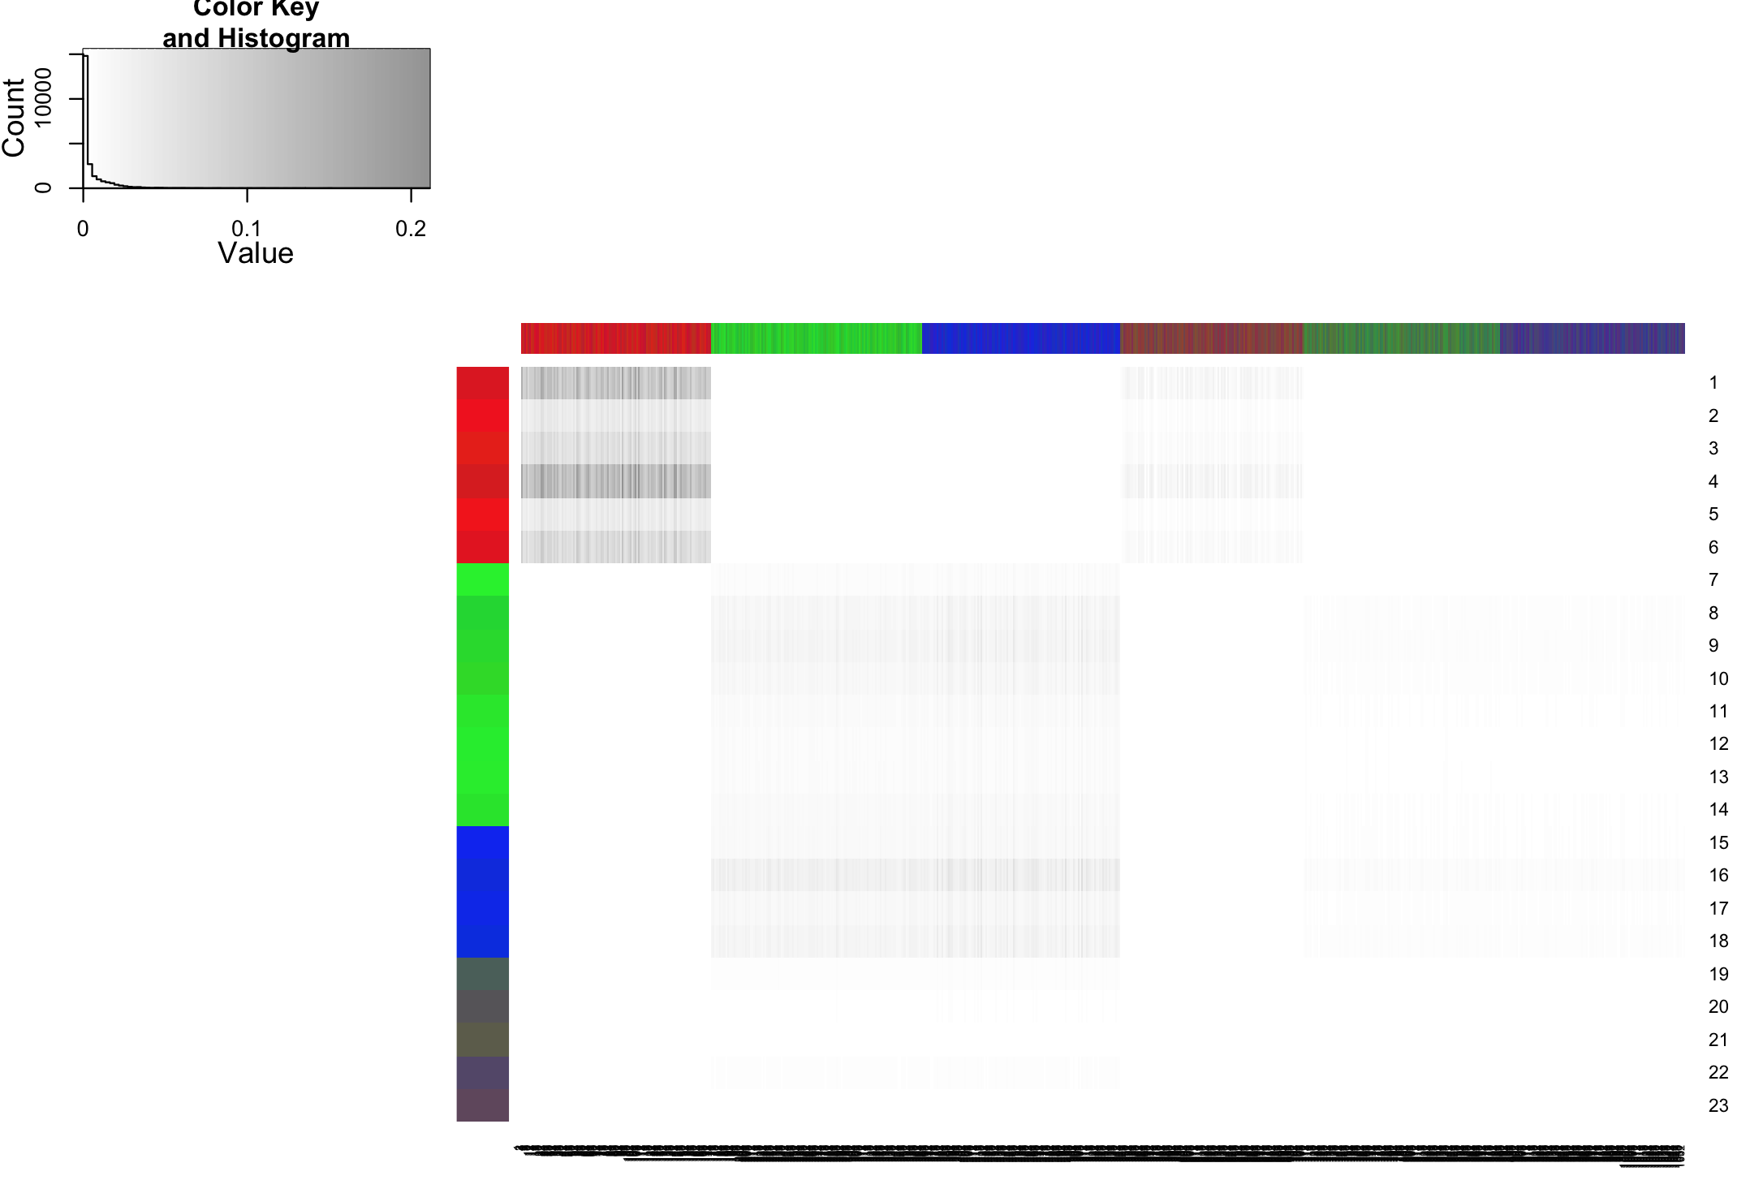
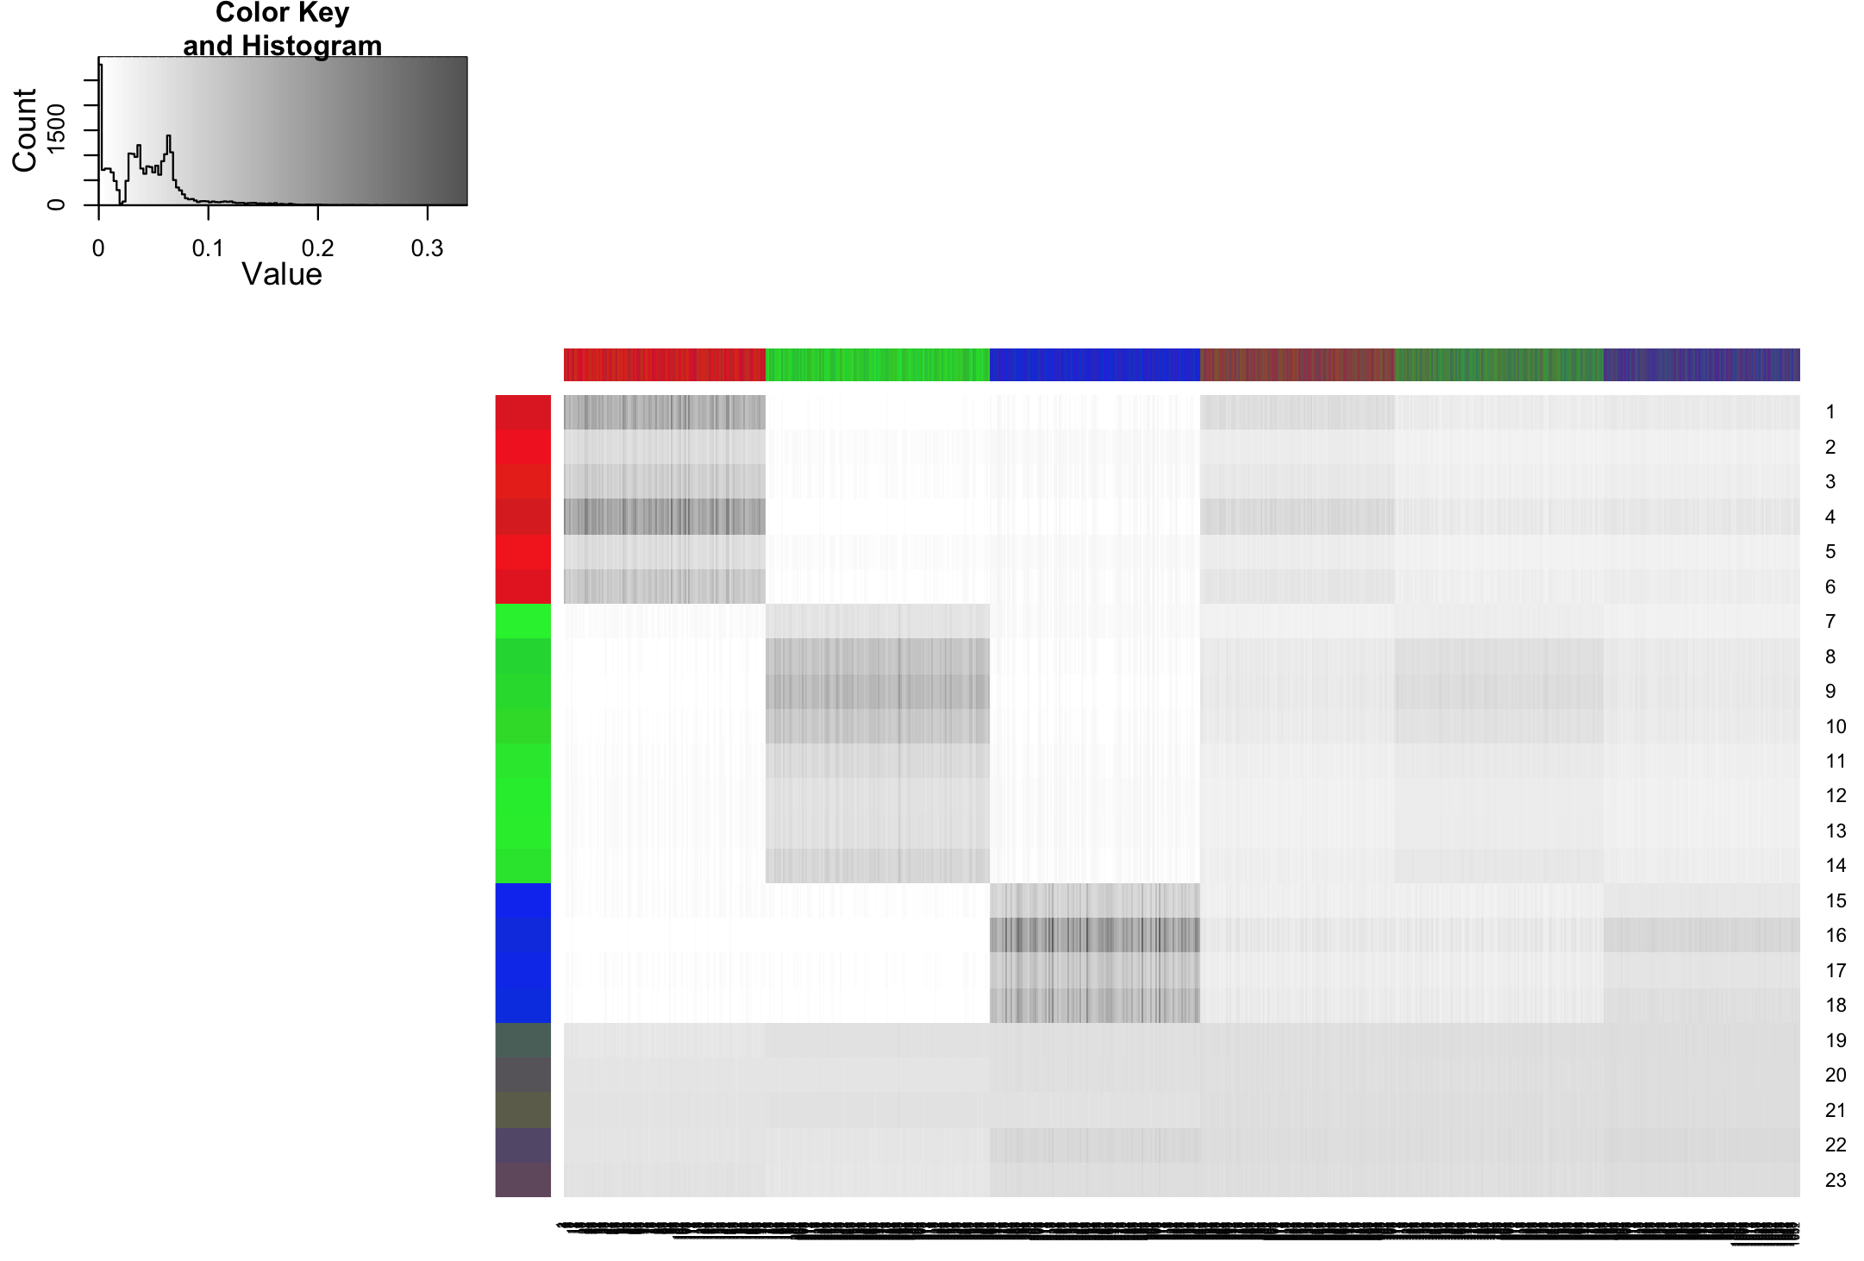
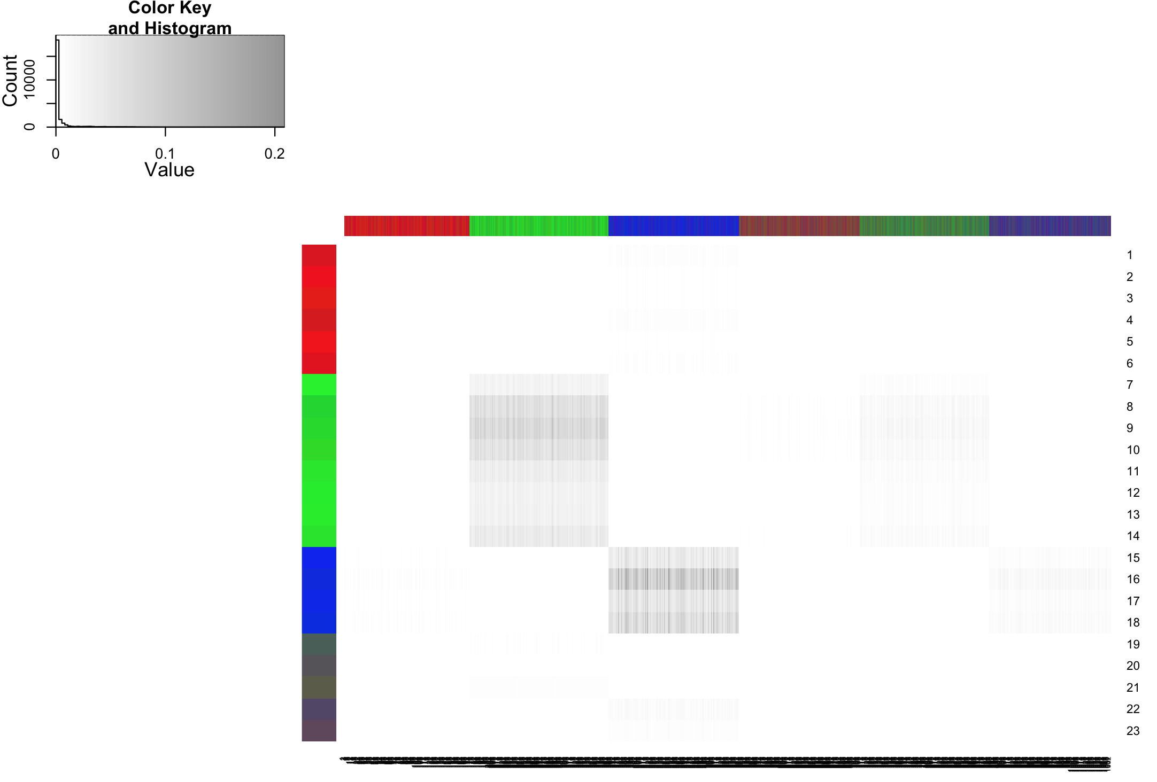

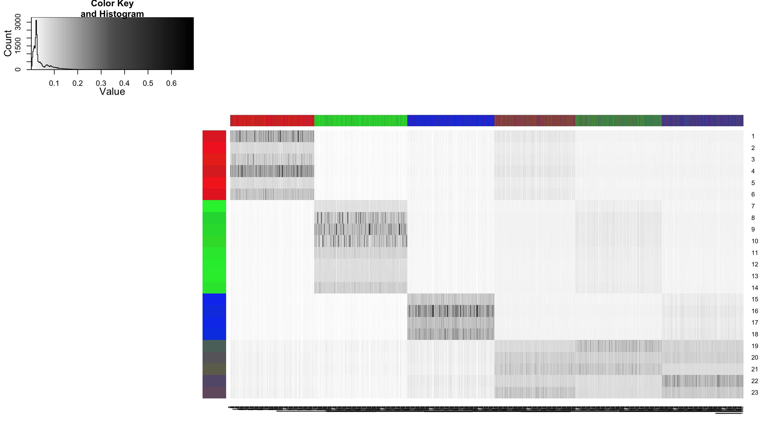
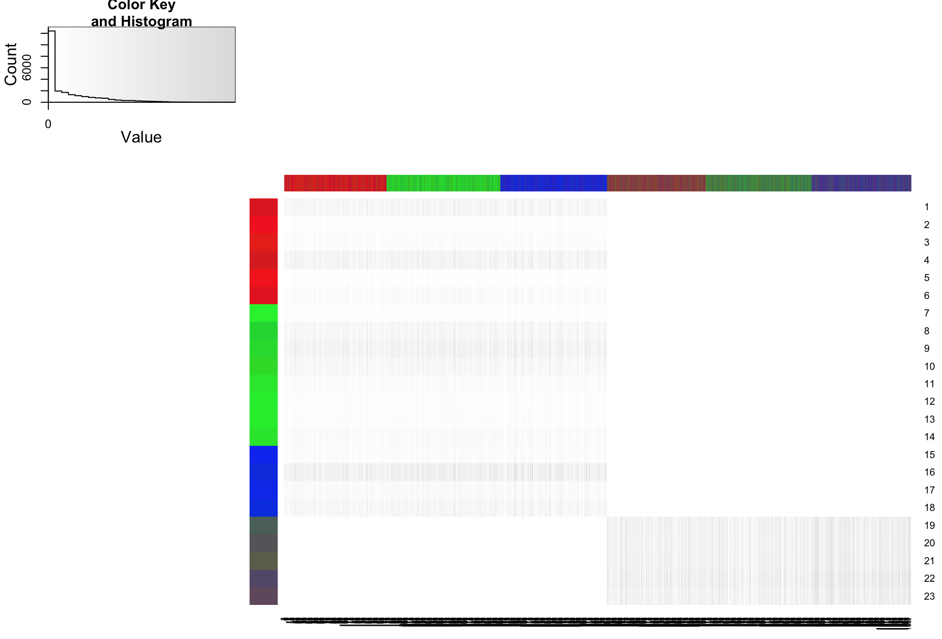
λ1=7
λ value
spectrum
Rank 2 approx.
λ2=3.9
+
spectrum
Rank 3 approx.
λ3=3.8
+
Rank 4 approx.
Original data
λ4=3.0
+

Slide 21
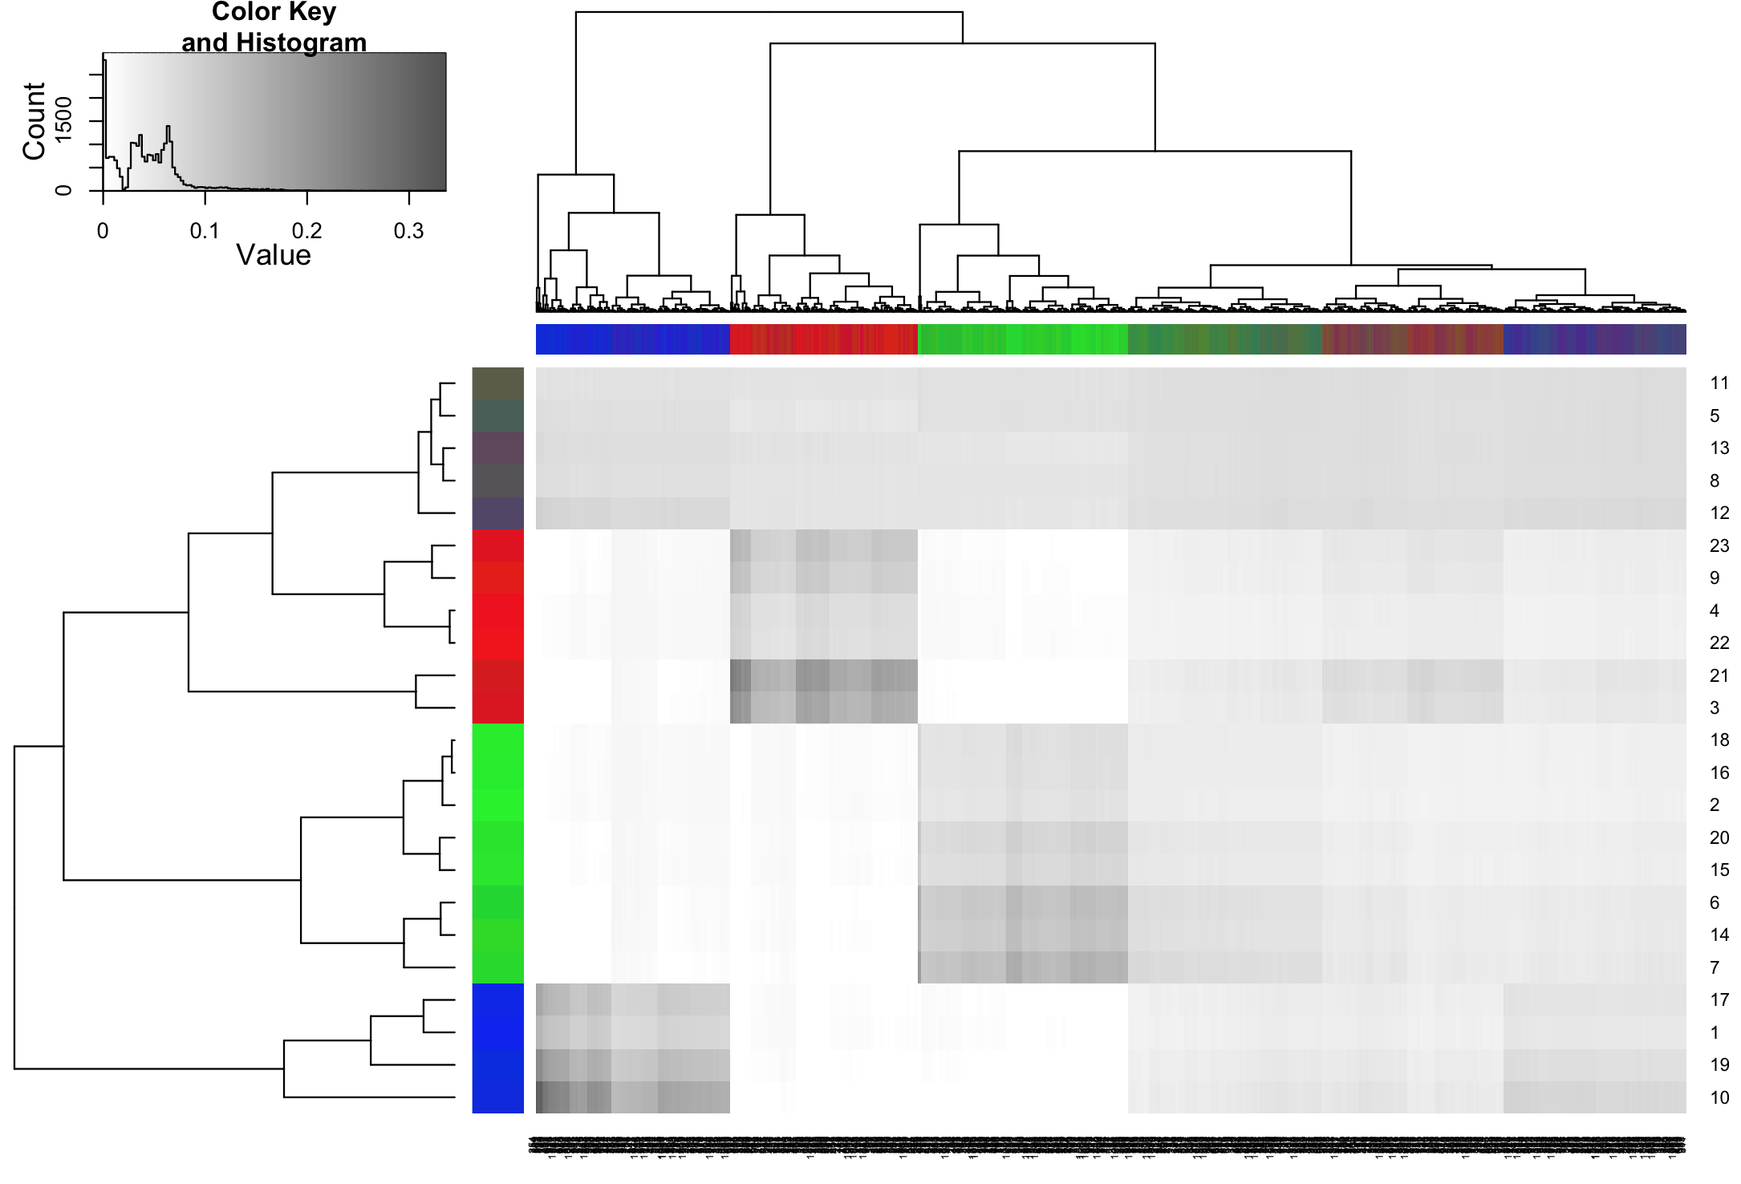
Reconstructed data matrix using only the top 3 components.
Hierarchical clustering works perfectly for both users and sites.

Slide 22
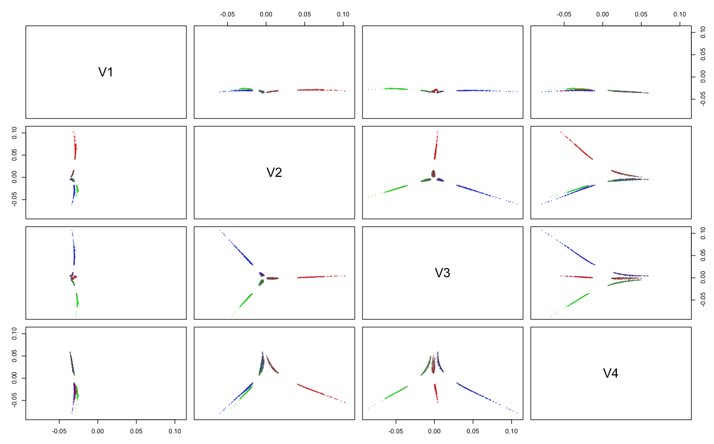
1052 users projected into top 4 principle dimensions
Notes:
First dimension is the artifact of choice of origin. It’s a very compressed dimension – almost a point. It has large distance from the origin.
This dimension corresponds to the background basis value for all data points.
The 2nd and 3rd dimensions corresponds to the primary dimensions of the 2D manifold, whose projects reveals the original relationship with some distortion.
SVD uses global linear embedding. One approach to approximate manifold is to use Local linear embedding (LLE)

Slide 23
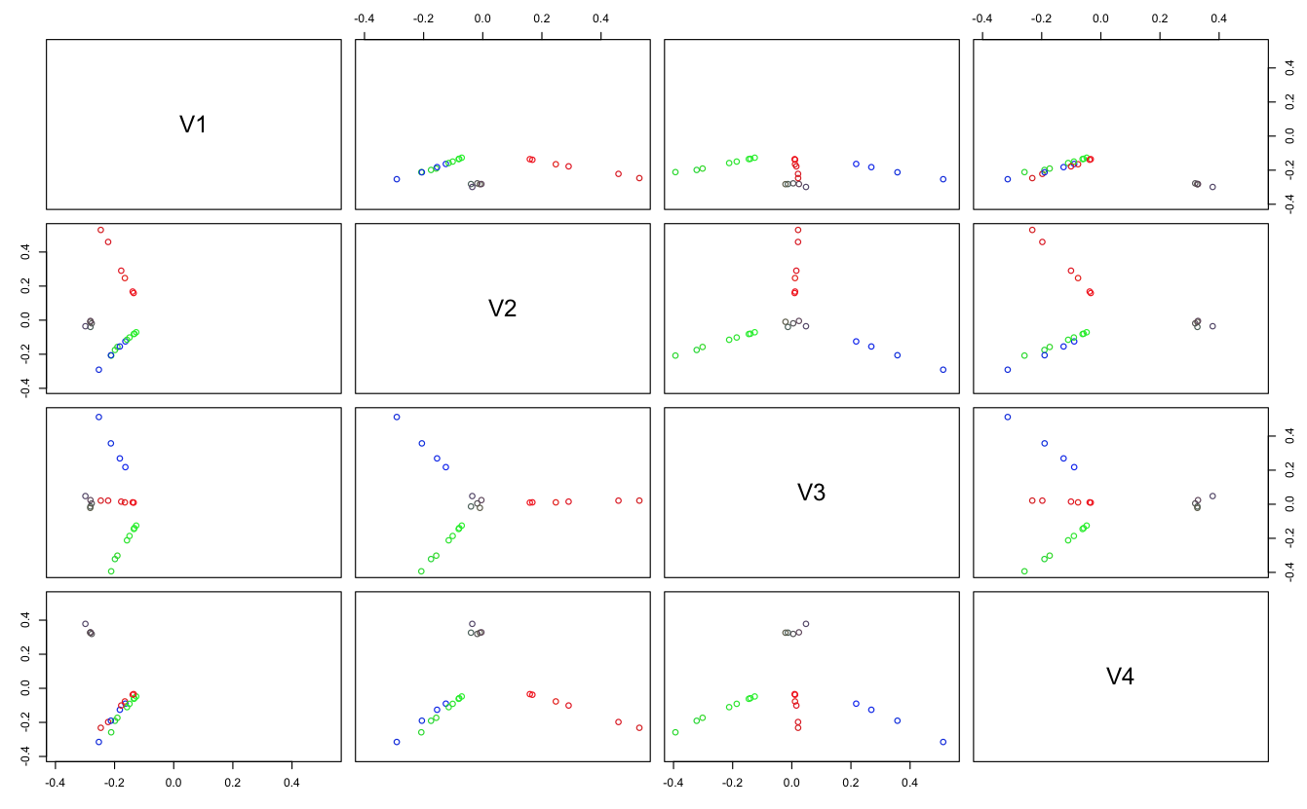
23 sites projected into top 4 principle dimensions

Slide 24
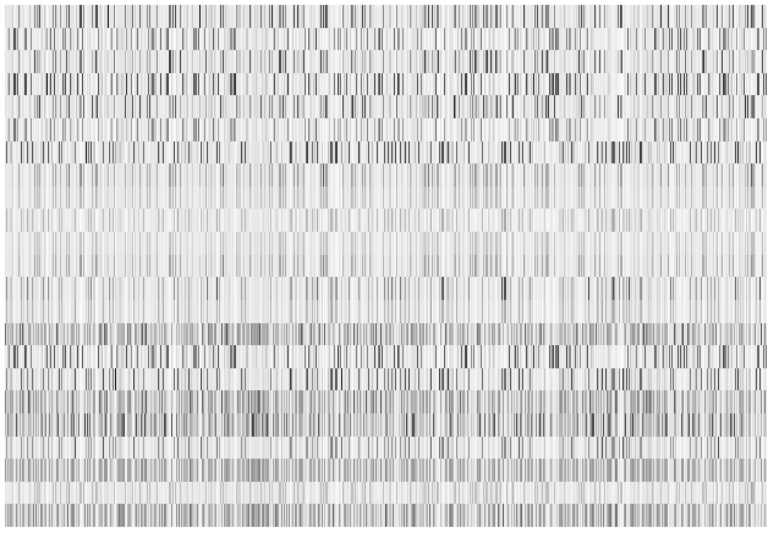
λ value
Dimension reduction
spectrum
users
Dimension reduction
sites
Bi-clustering
Co-clustering
Spectral partitioning:
Bi-partition data using top spectrum(s), recursively

Slide 25
Two Challenges
Solving the clustering problem
NP-hard
Graph partition
Specifying the clustering problem
d-dimensional space: O(n^{dk})
n: number of data
d: number of dimensions
k: number of clusters
Subjective Choices:
feature space
clustering criteria
General Strategies:
distance metric
number of clusters
Dimension reduction
(reduce d)
Heuristic search
(greedy algorithm)
Recursive bipartition
(reduce k)
Tens of clustering algorithms: k-means, agglomerative hierarchical clustering, spectral clustering, kernel-based clustering, GMM, other probabilistic models …
Notes:
Outcome depending on subjective choices is not good.
Curse of dimensionality.
The hierarchical clustering algorithm just saw is greedy algorithm, can be badly stuck at local minimum when the landscape is complex: when there is large amount of data, high dimension
Dimension reduction approach leads to better global solution.
Recursive bipartition can always be used.

Slide 26
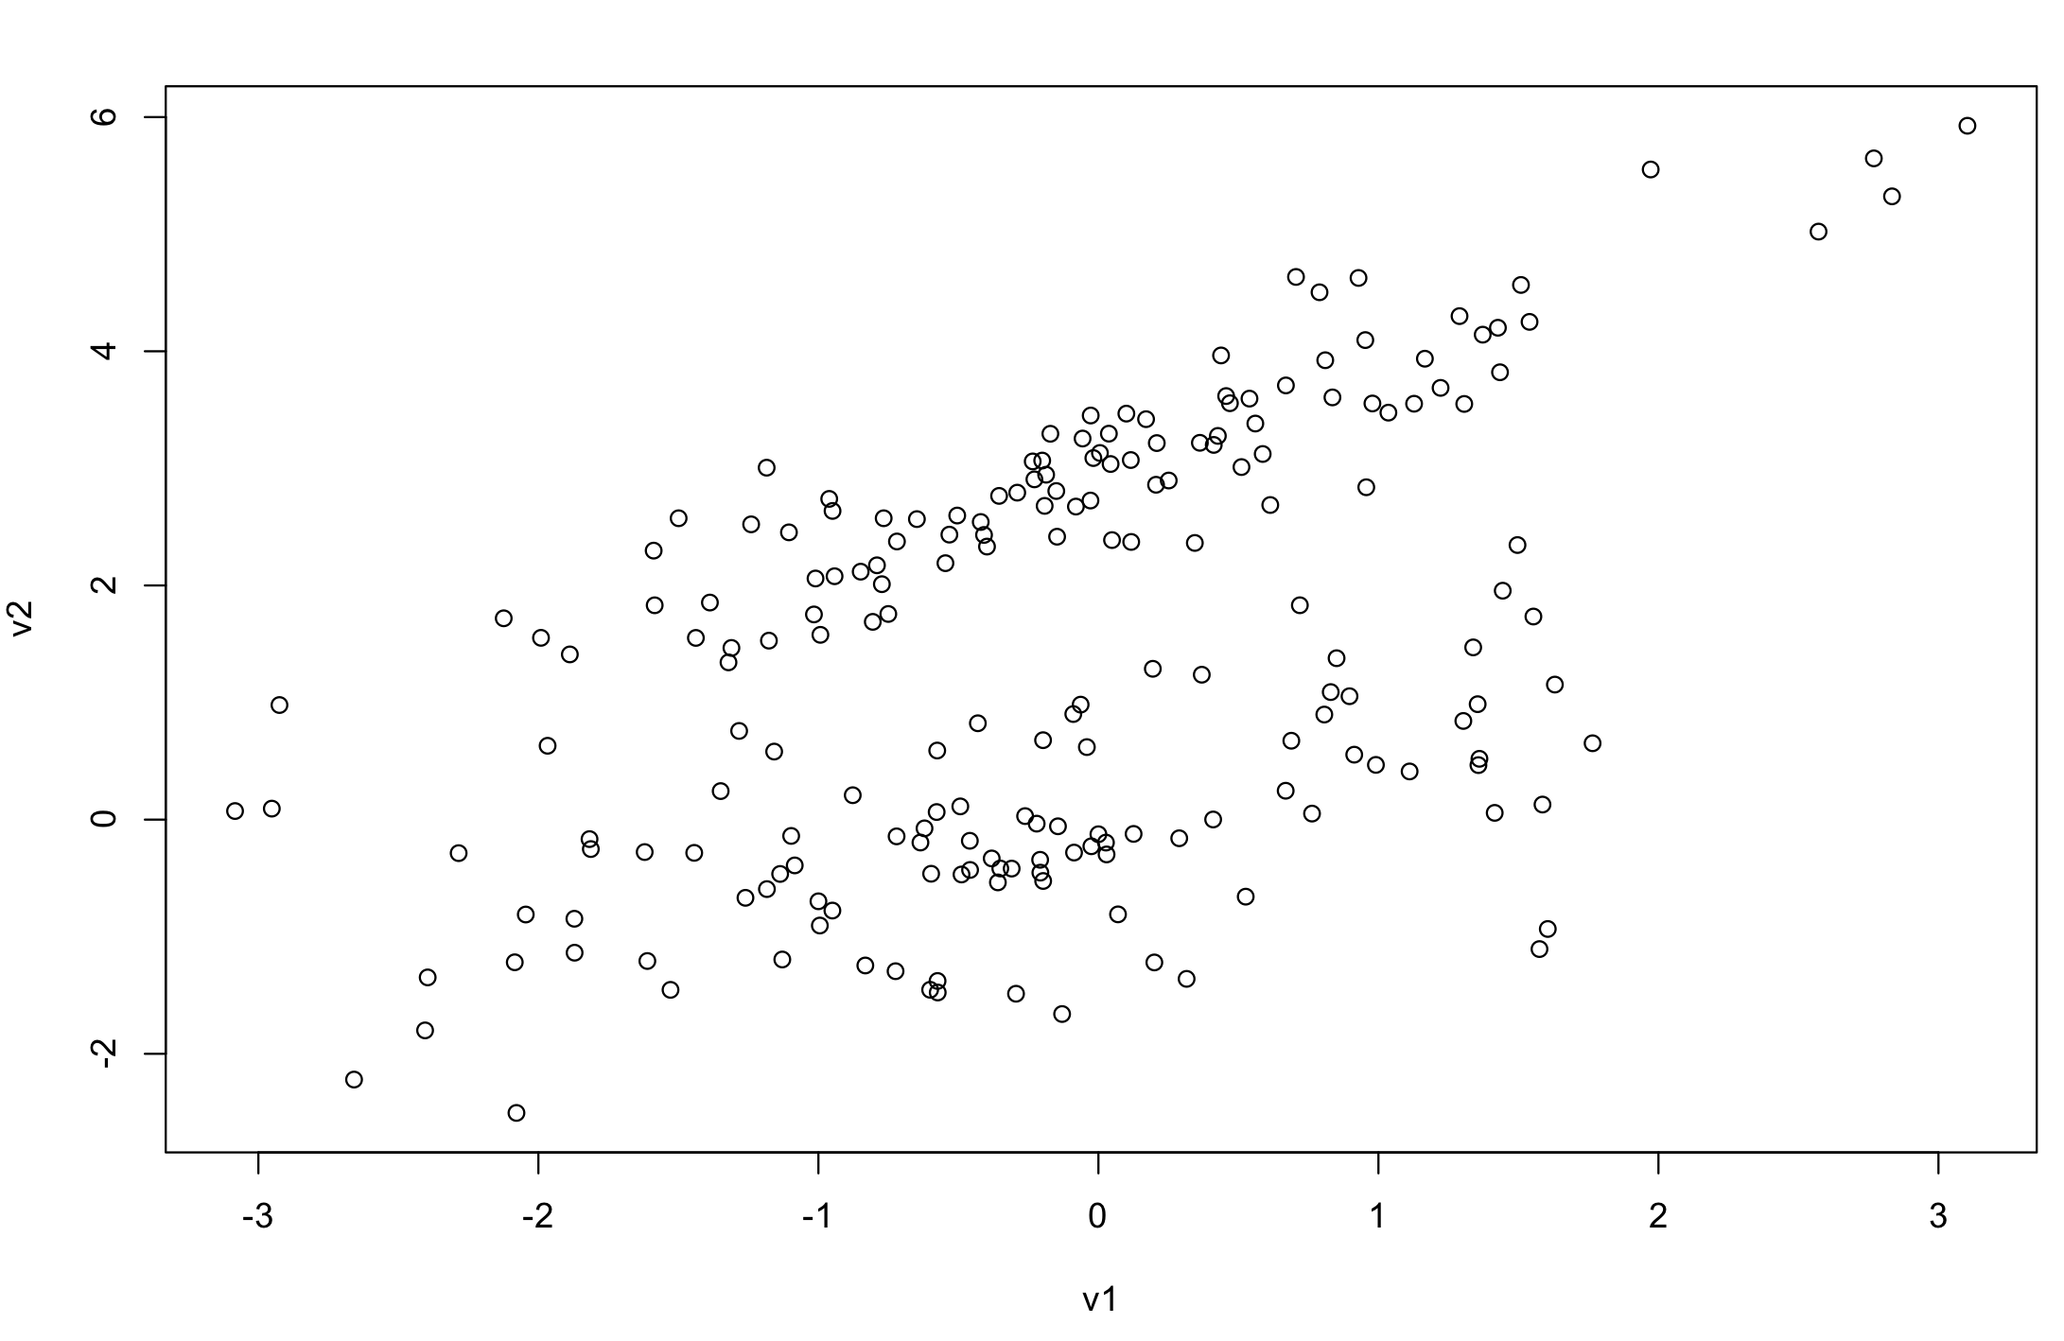
How Many Clusters Are There?

Slide 27
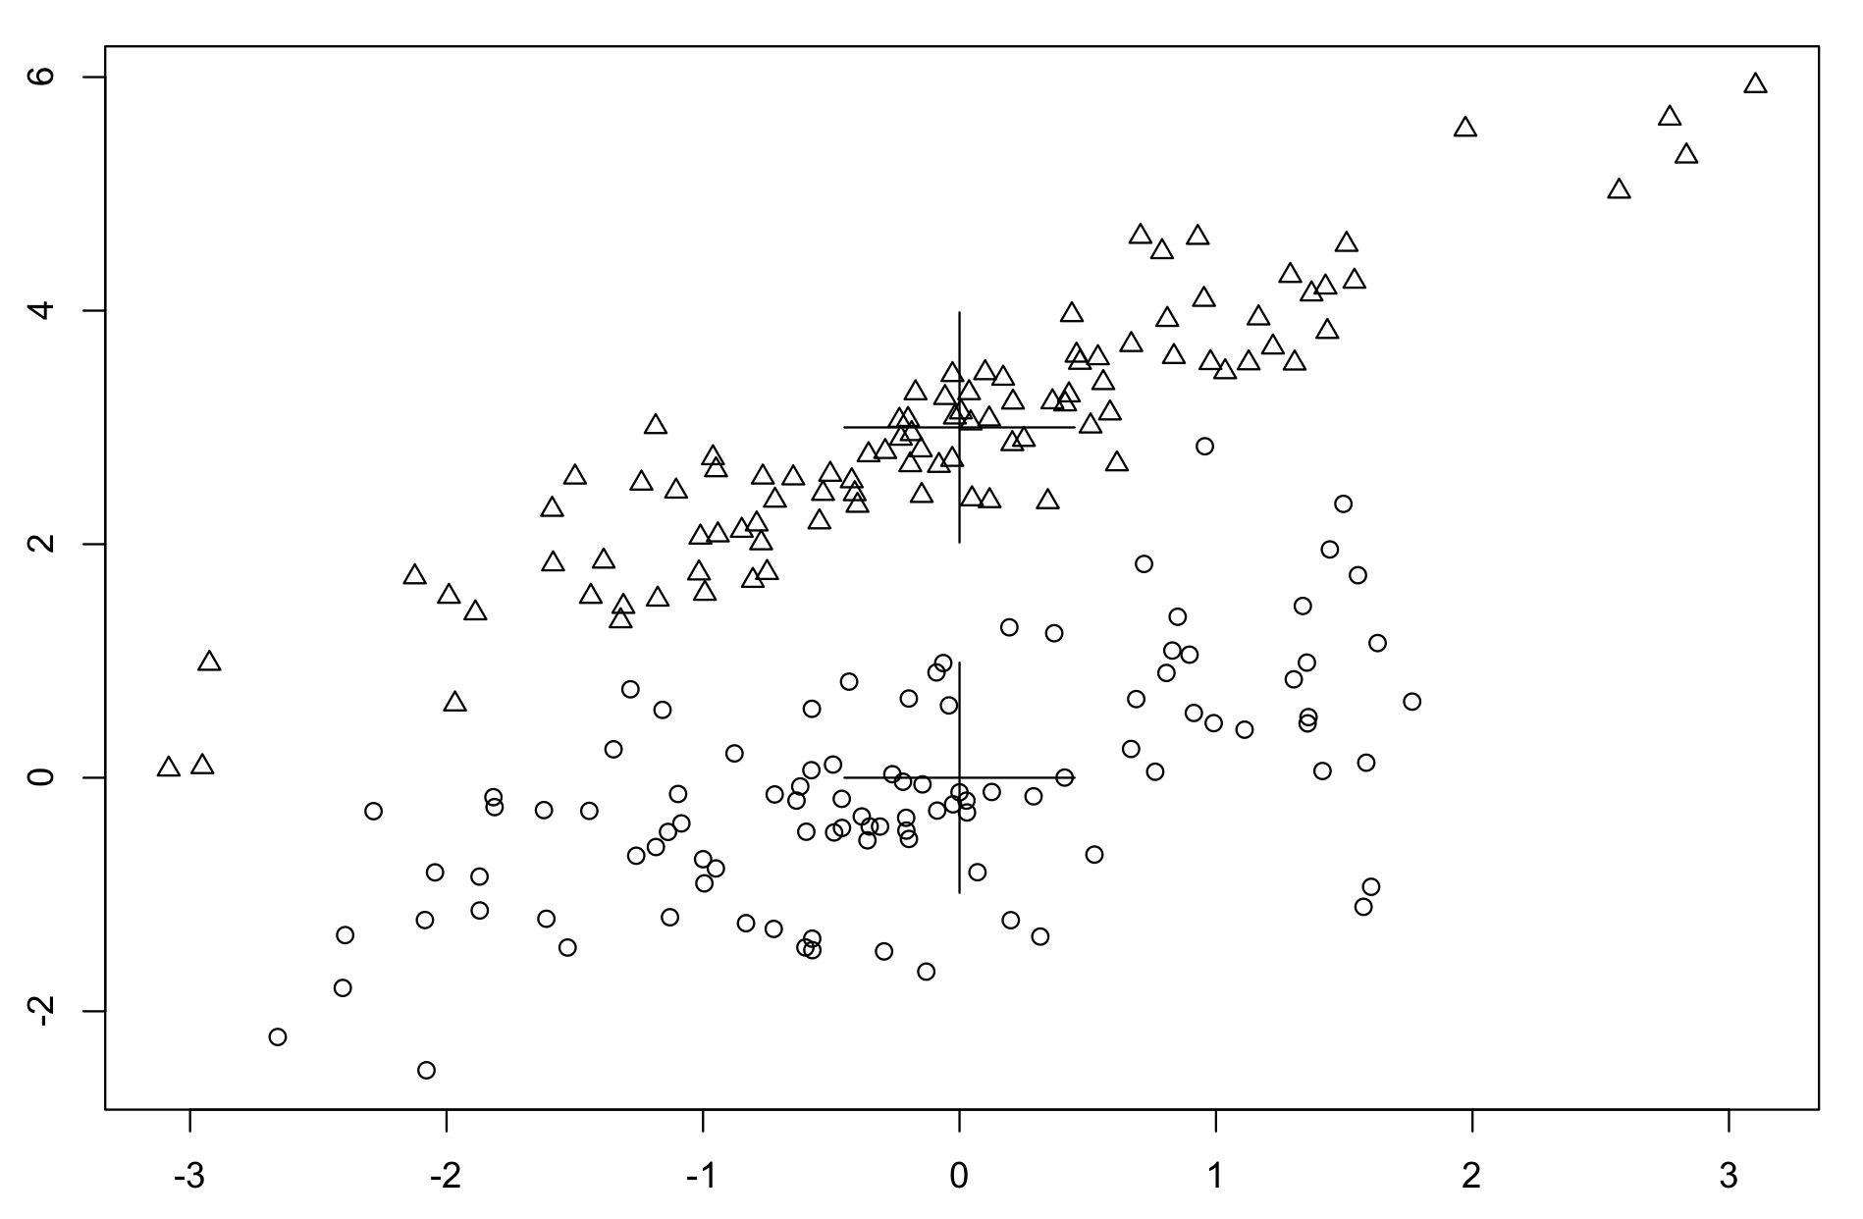
Generated by Two Bivariate Gaussian
How well will k-means clustering work?

Slide 28
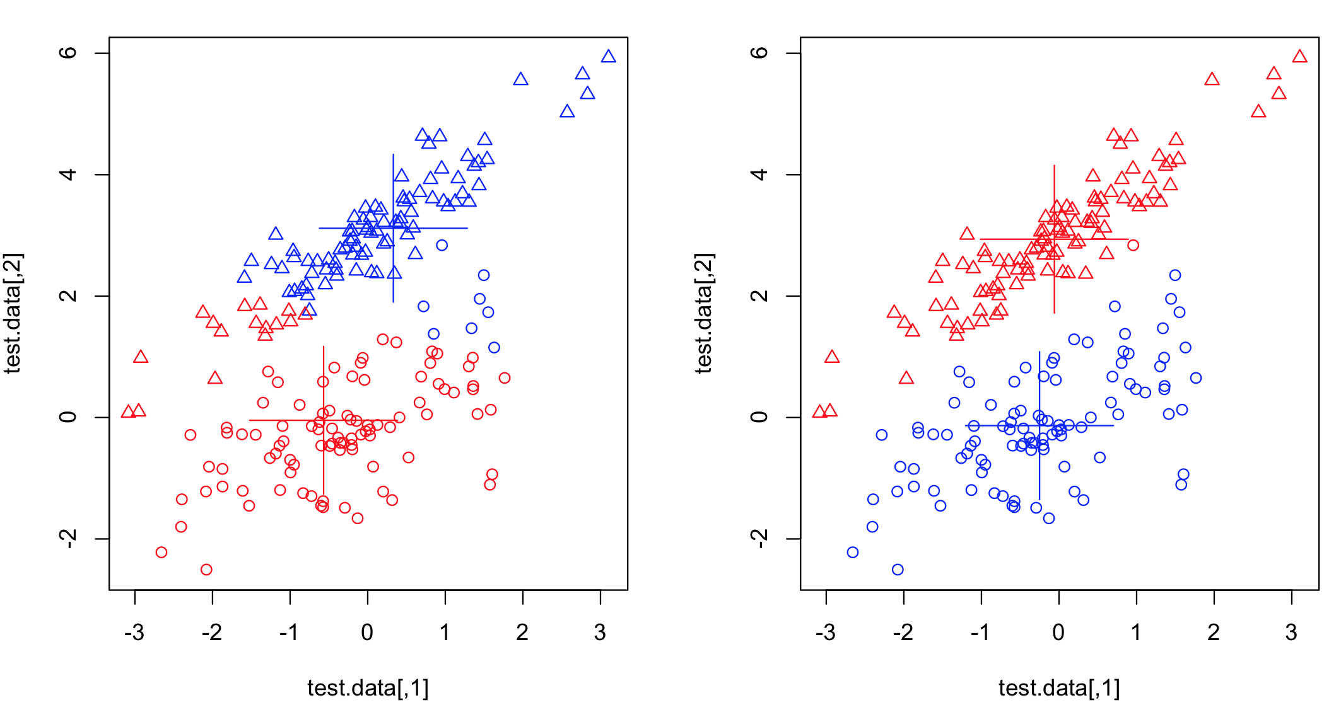
Method | K-means | Gaussian Mixture Model
Distance metric | Euclidean distance | Mahalanobis distance
Cluster representation | Exclusive membership | Probabilistic membership
Clustering Criteria | Minimize distance-to-center^2 | Maximum likelihood
Result | A lot of errors | Perfect
actual class (shape)
actual class (shape)
computed class (color)
computed class (color)
Notes:
K-means boundary is always a line. Or a plane, hyper-plane in higher dimensions

Slide 29
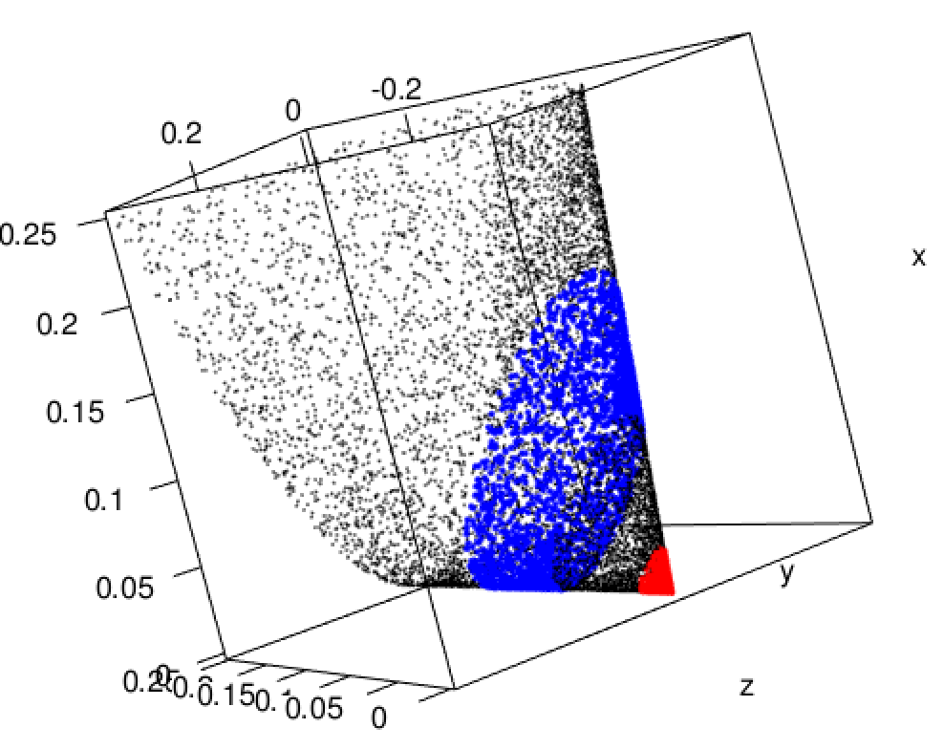
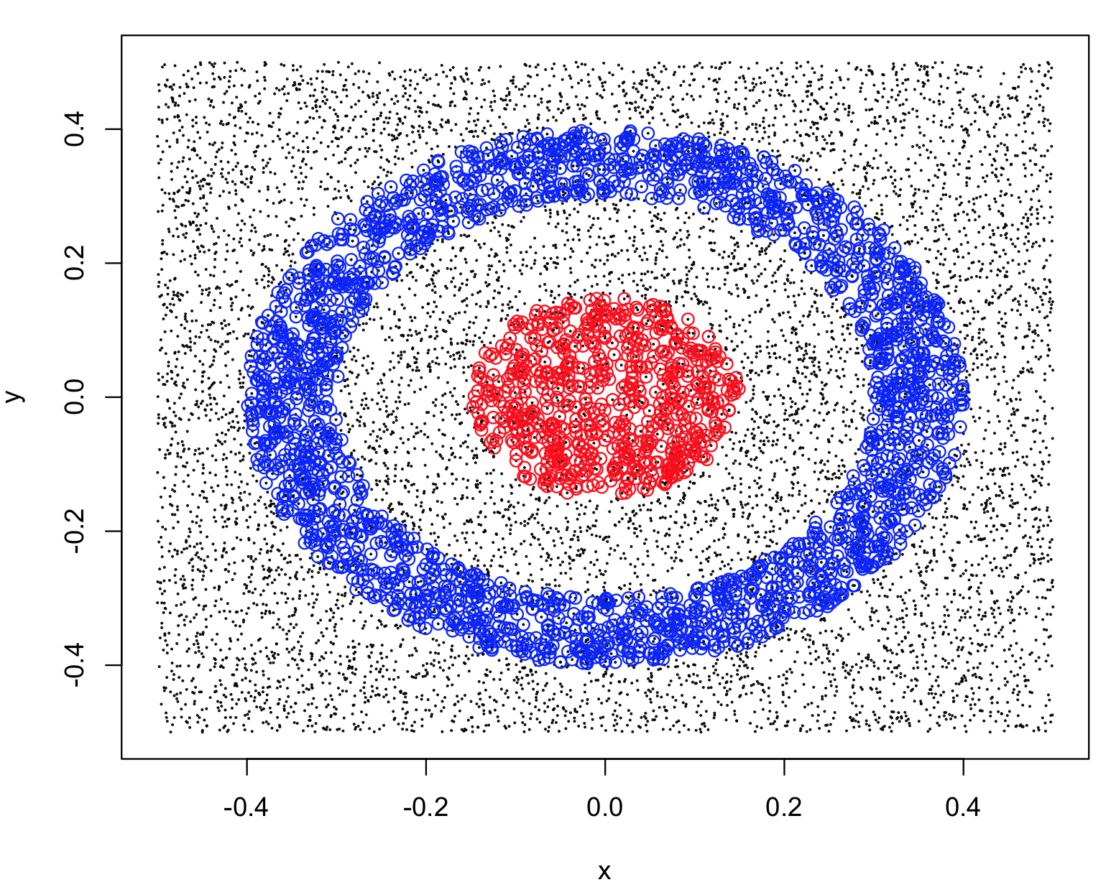
N data points on 2D manifold embedded in 3-dimensional space
N data points in 2-dimensional space
K-means won’t work
Feature space
N*d matrix
x_{i}, y_{i}
x
y
x_{i} = x_{i}², y_{i} = y_{i}², z_{i} = x_{i}*y_{i}*sqrt(2)
x
y
z
N*N kernel matrix
(dot-produce matrix,
Inner-product matrix)
x_{i}x_{j} + y_{i}y_{j} = k_{ij}
x_{i}² x_{j}² + y_{i}² y_{j}² +2x_{i}y_{i}x_{j}y_{j}= k_{ij}²
Kernel trick
(Polynomial kernel)
k_{ij}
k_{ij}²
Notes:
Many algorithms works only with dot products matrix. For example, svm, PCA (eigen decomposition)
Not all kernel tricks corresponds to intuitive transformation. For example, Gaussian kernel -> infinite dimension Hilbert space.
But all valid kernel creates a (nonlinear) manifold with the original number of dimensions in the higher dimensional space

Slide 30
sites
topics
sites
SVD
weighted sum of element-wise products
0
topics
users
users
0
=
D
V^{T}
users
M
sites
U
users
users
users
sites
=
K
M
M^{T}
topics
sites
topics
=
0
0
users
topics
topics
V
0
0
U^{T}
users
U
sites
D^{T}
D
V^{T}
Eigen Decomposition
users
topics
topics
=
0
users
users
0
U^{T}
users
K
U
D²
Notes:
Apply kernel trick, now user is nonlinearly transformed to a different space.
It’s equivalent to linear rotation in a higher dimension feature space that corresponding to the kernel function.

Slide 31
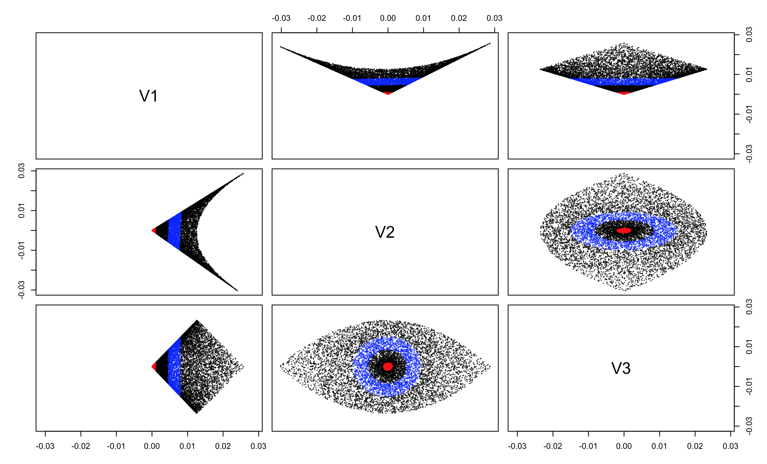
Kernel k-means:
With polynomial kernel, the data is transformed into a different space.
k-means clustering can separate (using a line) the red and blue with the first spectrum.

Slide 32
Two Challenges
Solving the clustering problem
NP-hard
Graph partition
Specifying the clustering problem
d-dimensional space: O(n^{dk})
n: number of data
d: number of dimensions
k: number of clusters
Subjective Choices:
feature space
clustering criteria
General Strategies:
distance metric
kernel tricks
number of clusters
Dimension reduction
(reduce d)
Heuristic search
(greedy algorithm)
Recursive bipartition
(reduce k)
Tens of clustering algorithms: k-means, agglomerative hierarchical clustering, spectral clustering, kernel-based clustering, GMM, other probabilistic models …
Notes:
Outcome depending on subjective choices is not good.
Curse of dimensionality.
The hierarchical clustering algorithm just saw is greedy algorithm, can be badly stuck at local minimum when the landscape is complex: when there is large amount of data, high dimension
Dimension reduction approach leads to better global solution.
Recursive bipartition can always be used.

Slide 33



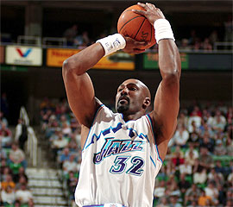
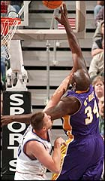
NBA Playing Styles
Point guard
(Jason Kidd)
Shooting guard
(Vince Carter)
Small forward
(Glenn Robinson)
Power forward
(Karl Malone)
Center
(Shaq O’Neal)
Game statistics:
rebounds, assists, turnovers, steals, blocked shots, personal fouls, points scored

Slide 34
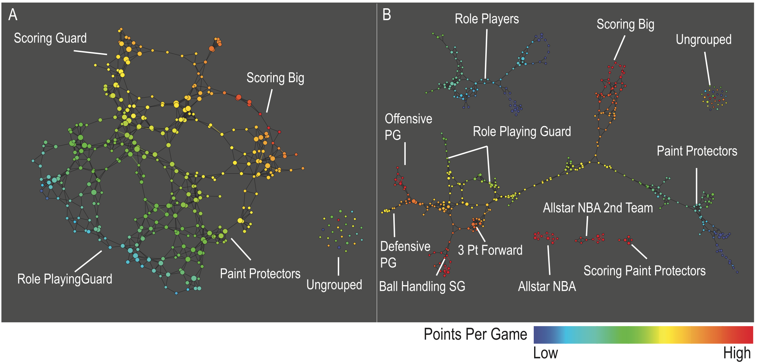
Topological Map of NBA Players
A. Low resolution map
B. High resolution map
452 players, 2010-2011 season performance profile (per minute):
rebounds, assists, turnovers, steals, blocked shots, personal fouls, points scored

Slide 35
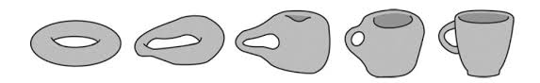
Topology
About qualitative and global shape
Unchanged under continuous deformations
Invariant under kernel tricks
Donut
Coffee cup
A topologist cannot tell the difference!

Slide 36
Comparing Clustering Analysis with Topological Data Analysis
Key Aspects | Clustering Analysis | Topological Data Analysis
Feature space | Limited choice of raw measures. Feature engineering | Limited choice of raw measures. Lenses (guided feature engineering)
Distance metric | Distance function Feature transformation Kernel tricks | Metrics (distance function)
Number of clusters | Recursive bipartition (hierarchical) Search for optimal k | 2 dimensions to explore: Resolution (number of nodes) Gain (number of edges)
Clustering criteria | A lot of variations
Implementation | Many clustering algorithms: Greedy search Dimension reduction Recursive partitioning Kernel tricks | Unified framework: Just present the graph No need to solve the NP-hard partitioning problem. Look for persistent homology
Notes:
Although any topologic structure is invariant under continuous transformation, there are exponentially many combinations of topological structures, which will appear under different resolutions.

Slide 37
Topological Representation
Kohonen Network
A.a.k. Self-organizing feature map
A type of neural network
Model of human cerebral cortex
Incremental and online learning
Complexity O(k*d) for each sample
Topological Data Analysis (TDA)

Slide 38
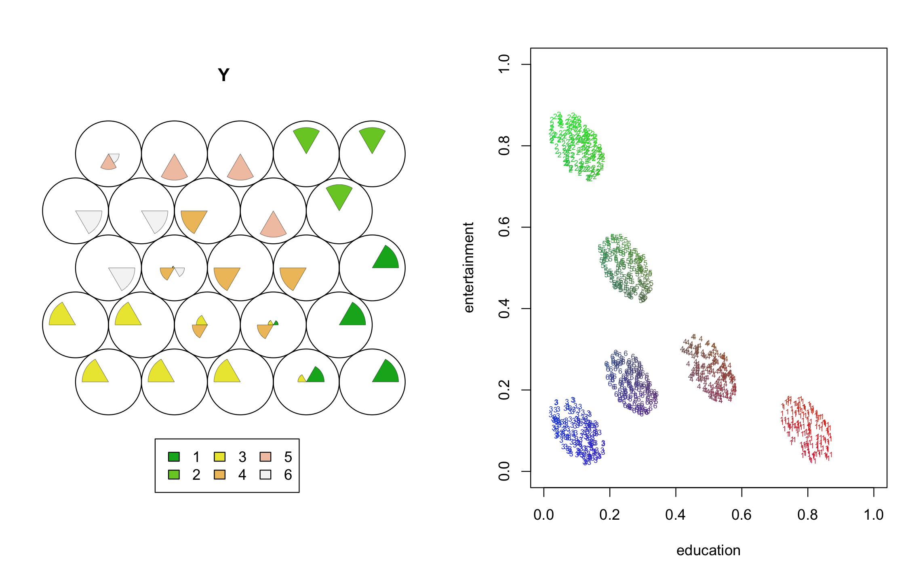
Kohonen SOM learned consistent Topological relation
2
2
5
6
4
5
1
3
4
6
1
3
Geometry is sensitive to choice of coordinates/scale of measurements
Topology is robust against distortion

Slide 39
Two Challenges
Solving the clustering problem
NP-hard
Specifying the clustering problem
d-dimensional space: O(n^{dk})
n: number of data
d: number of dimensions
k: number of clusters
Graph partition
Subjective Choices:
General Strategies:
feature space
clustering criteria
Dimension reduction
(reduce d)
distance metric
kernel tricks
number of clusters
Heuristic search
(greedy algorithm)
Recursive bipartition
(reduce k)
Tens of clustering algorithms: k-means, agglomerative hierarchical clustering, spectral clustering, kernel-based clustering, GMM, other probabilistic models …
Don’t cluster
Topological Data Analysis
Notes:
Outcome depending on subjective choices is not good.
Curse of dimensionality.
The hierarchical clustering algorithm just saw is greedy algorithm, can be badly stuck at local minimum when the landscape is complex: when there is large amount of data, high dimension
Dimension reduction approach leads to better global solution.
Recursive bipartition can always be used.

